Slide 1
Cryo AIP
Current status
Arkadiy Klebaner
November 21, 2012

Slide 2
Scope
Compressor system
Refrigeration system
Cryogenic storage and inventory management
Muon g-2 cryogenic distribution system
Mu2e cryogenic distribution system
Auxiliary systems

Slide 3
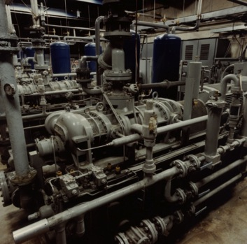
Compressor system
A0 compressors (four skids)
Each skid consists of the following:
  Two-stage oil injected screw compressor
  300 kW motor
  60 g/s capacity
  Compression from 1 atm to 20 atm
  Slide valve for capacity control
  6 kW oil pump
  Oil cooler heat exchanger
  Aftercooler heat exchanger
  Oil separator
  Oil removal system
  Entire system is contained on a single,
  fabricated steel base skid, oil removal
  on separate skid
Two-stage compound oil flooded
screw compressor Mycom 2016C

Slide 4
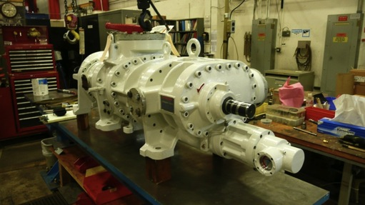
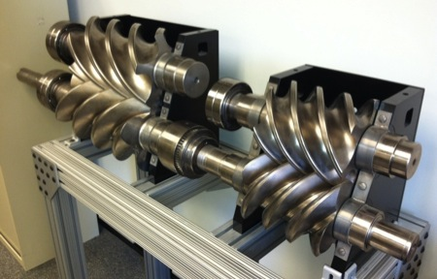
Compressor system (cont.)
Mycom 2016C Two-Stage
Helically grooved rotors

Slide 5
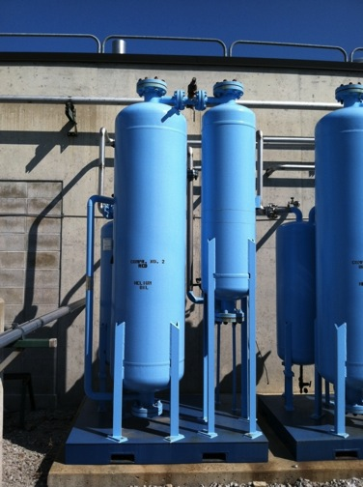
Oil Removal System
Four skids
Consists of:
Oil Separator (located on compr skid)
Oil Coalescers (3 stages)
Charcoal Adsorber
  Removes oil vapor
Molecular Sieve
  Removes water vapor
Final Filter
  Contains 1 micron filter element

Slide 6
Refrigeration system
The system consist of four refrigerators (two dedicated refrigerators for each experiment)
Total theoretical capacity is:
2,500 [W] @ 4.5 K
or
16 [g/sec]
(4 x 625 [W] or 4 x 4 [g/sec])

Slide 7
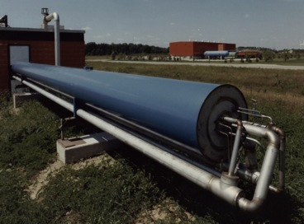
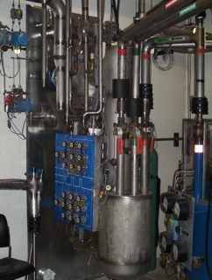
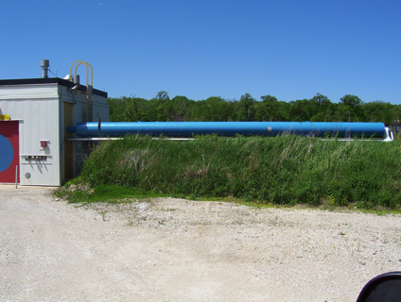
Heat Exchanger
35 ft. long heat exchanger
Consists of four heat exchangers
housed in a single cryostat
Nitrogen precooling
U-tube connections for high pressure,
low pressure helium and gas
expander

Slide 8
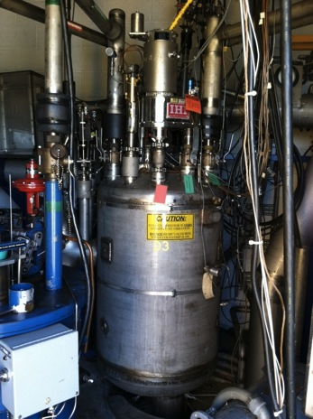
Refrigerator Valve Box
Connects all refrigerator components
together using u-tubes
Provides positive isolation between
different components by removing
u-tubes
Distributes cryogens to and from load
and includes necessary control valves
Contains 130 liter subcooling dewar

Slide 9
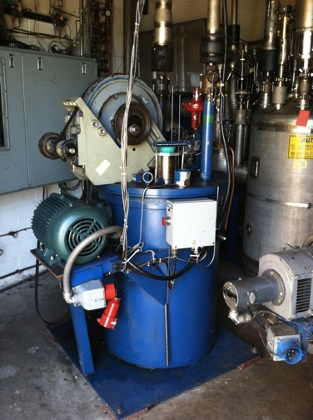
Expansion Engines
Two engine types
  Liquid “wet” expansion engine
  30K gas “dry” expansion engine
  3 in and 2 in piston sizes
  2 hp and 7.5 hp respectively

Slide 10
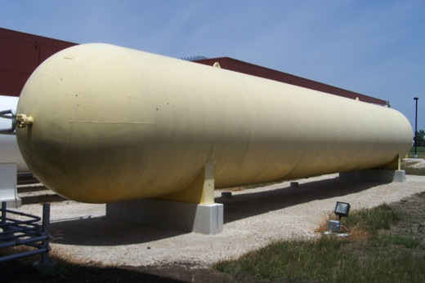
Gas Storage
Two gas storage consists of 30,000 gal nominal capacity storage tanks
Overall length of 66 ft with an outside diameter of 9 ft

Slide 11
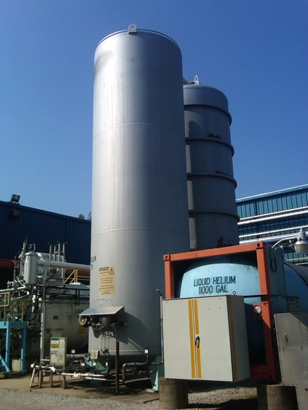
Nitrogen Tank
15,000 gal
MAWP 150 psig
10' outside diameter
30' tall
65,000 # empty

Slide 12
Functional Requirements
Detailed requirements are listed in the “ Muon Campus Cryogenics: Functional Requirements Specification” document #4248 in DocDb, initial release October 2, 2012
https://beamdocs.fnal.gov/AD-private/DocDB/ShowDocument?docid=4248
The document is agreed upon and signed by both experiments and management

Slide 13
Key Requirements
Cryogenic loads:
Muon g-2
  Liquefaction load – 1.4 [g/sec]
  Refrigeration load – 300 [W]
  LN2 Shield flow rate – 1.6 [g/sec]
Mu2e
  Liquefaction load – 0.8 [g/sec]
  Refrigeration load – 350 [W]
  LN2 Shield flow rate – 20 [g/sec]

Slide 14
Key Requirements (cont.)
The Cryogenic System shall support simultaneous steady state operation of both experiments, Muon g-2 and Mu2e. It shall provide for independent operation of the two experiments, including transient modes, e.g. warm-up, cooldown, etc.
It should be possible to connect and/or isolate Mu2e magnets from the transfer line while under cold conditions

Slide 15
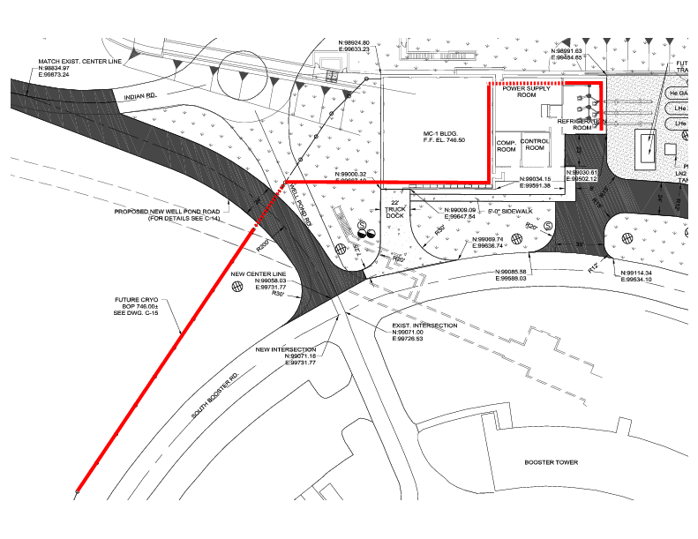
Piping headers
Towards A0

Slide 16
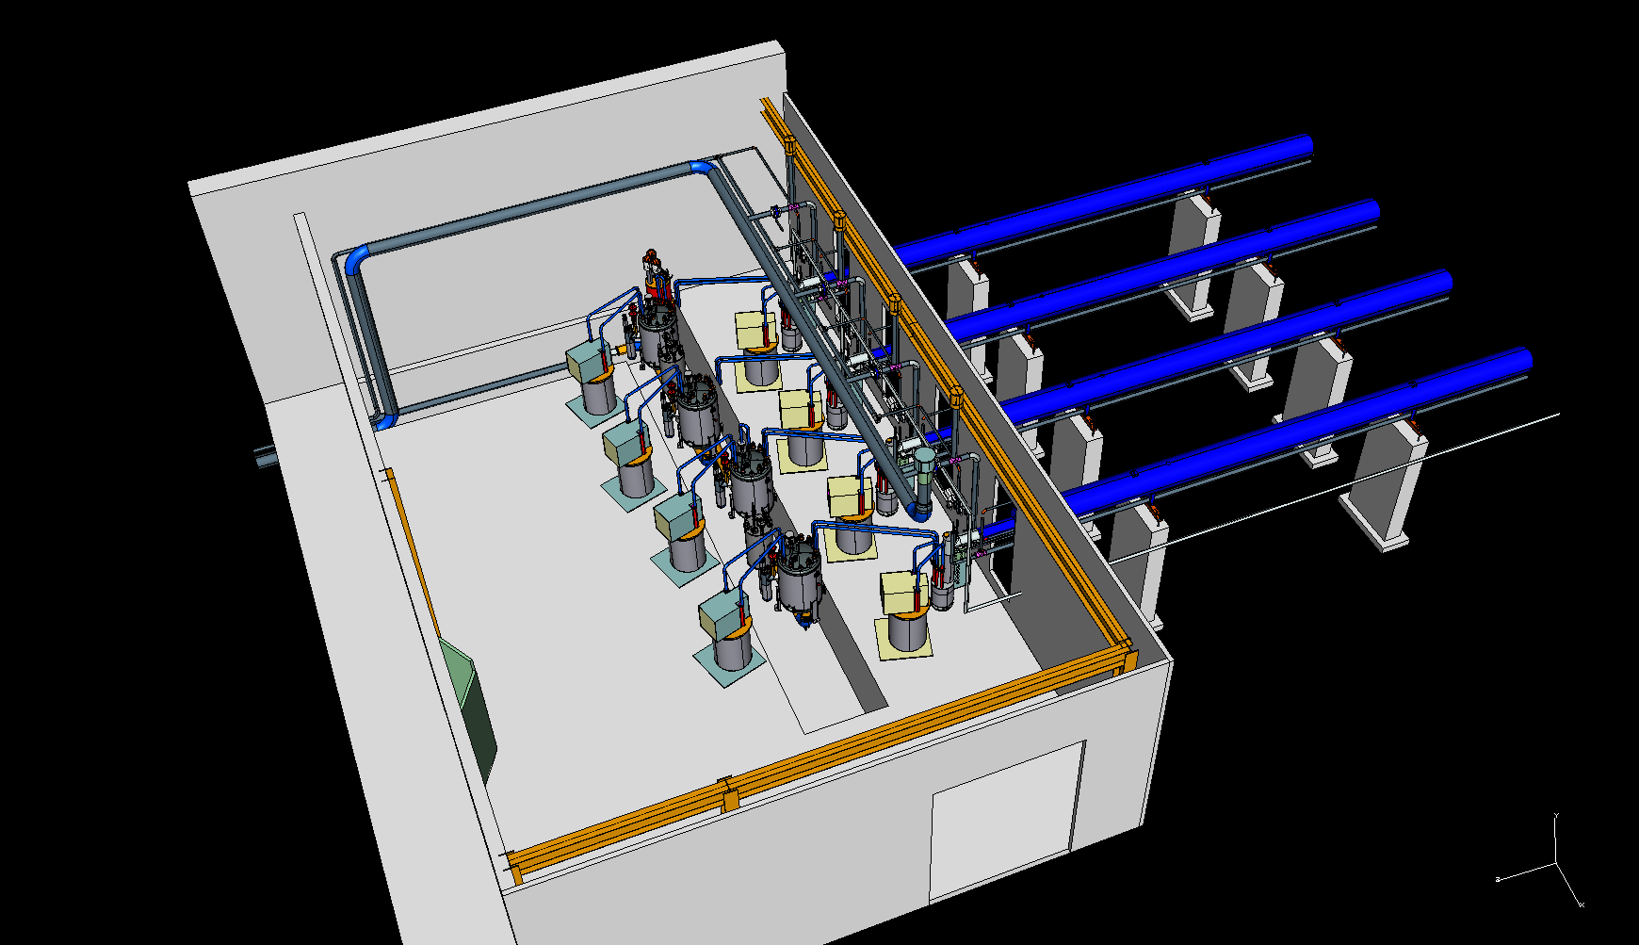
Refrigerator room

Slide 17
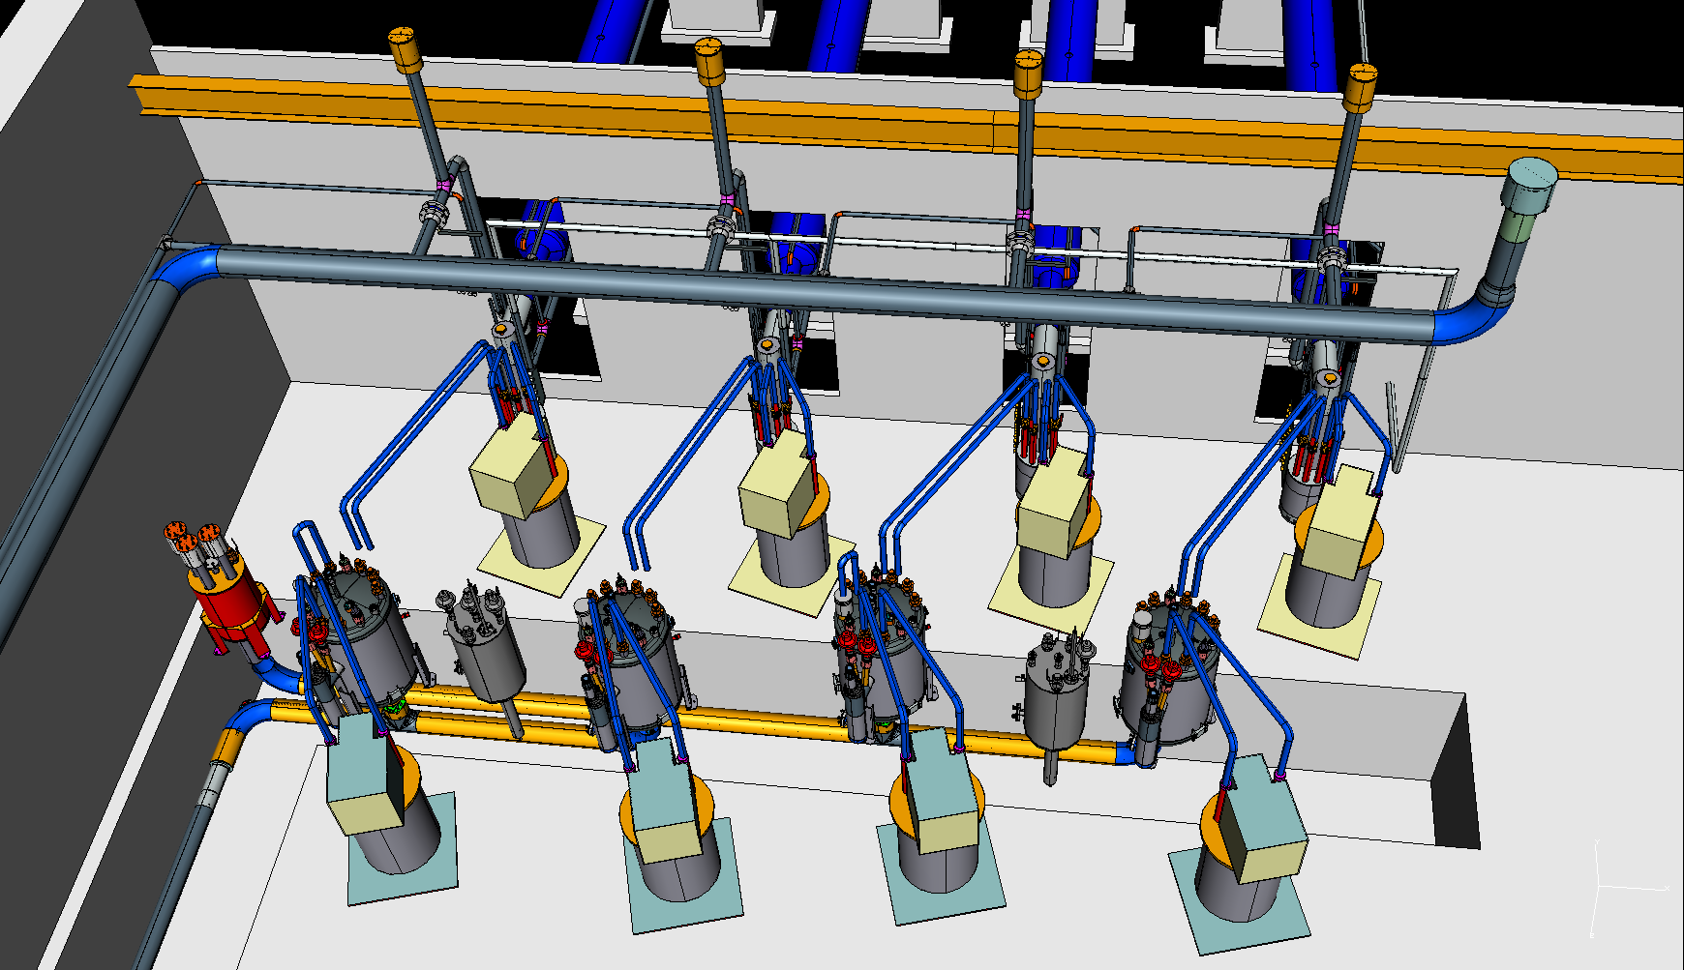
Refrigerator room (cont)

Slide 18
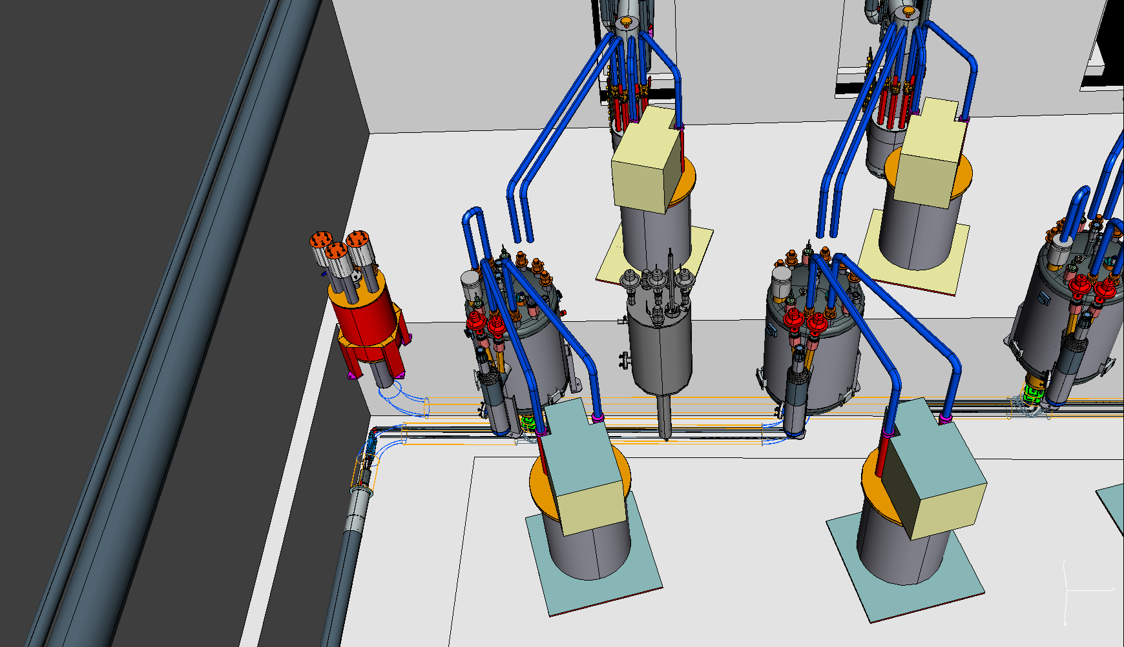
Transfer line

Slide 19
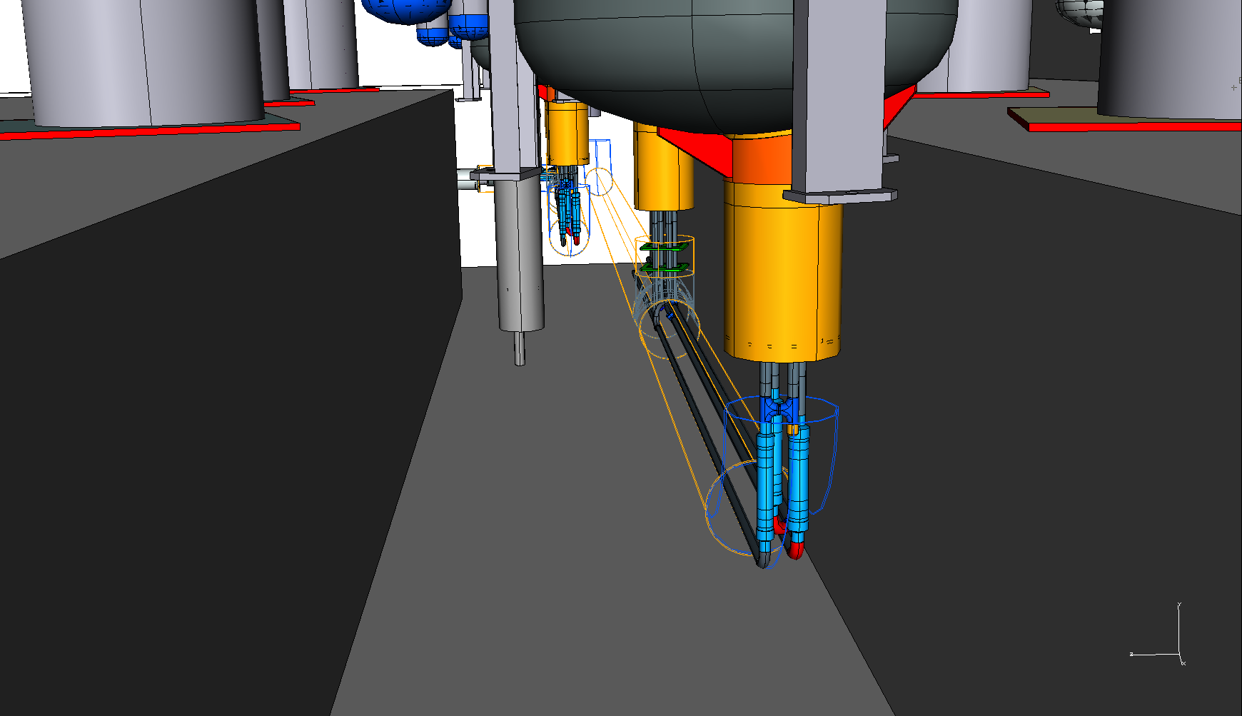
Transfer line (cont)

Slide 20
Project Plan
Baseline Costs

Slide 21
Escalation and Contingency
Escalation
  M&S= 2.7% /year
  SWF= 2.7 % /year
Contingency
  Average 25%
  Exception on items similar to the currently procured for other projects. The smallest is 20%

Slide 22
Funding Profile

Slide 23
Labor by Categories

Slide 24
FY 13 M&S
Long lead items procurement
Removing equipment and refurbishing TeV equipment (1 FTE)
E&D (1 FTE)

Slide 25
FY14 M&S
Installing TeV equipment
Running headers from A0
Connecting to g-2
Cooling down g-2
9 FTE

Slide 26
FY15
No M&S
Mu2e E&D work (1.5 FTE)
Will need g-2 operational funds

Slide 27
FY16
Procuring Mu2e transferline components
Refurbishing and installing TeV transferline, expansion box and headers
Refurbishing and installing AP10 bayonet can
2.8 FTE

Slide 28
FY17
Connecting Mu2e
Cooling down Mu2e
0.8 FTE

Slide 29
Timeline
2013
2014
2015
2016
2017
Plant and g-2
Mu2e distribution
g-2 cryo distribution
Mu2e cryo distribution
Compressors
Refrigerators
g-2
g-2
Mu2e
Engineering and design
Procurement and installation
Refurbishment and installation
Cooldown

Slide 30
Milestones

Slide 31
Thank you

